Slide 1
A Brief History of Computer Go
Dr. Chun Sun (Microsoft Inc, Boston)
For HXGNY GO EXPO, June 2013

Slide 2
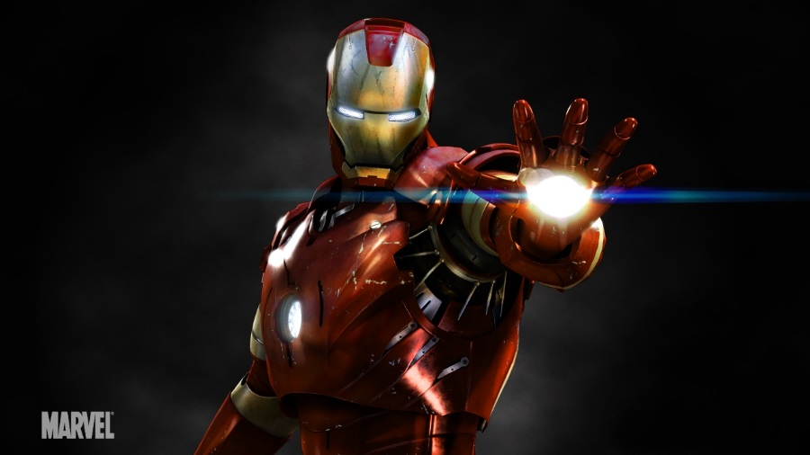
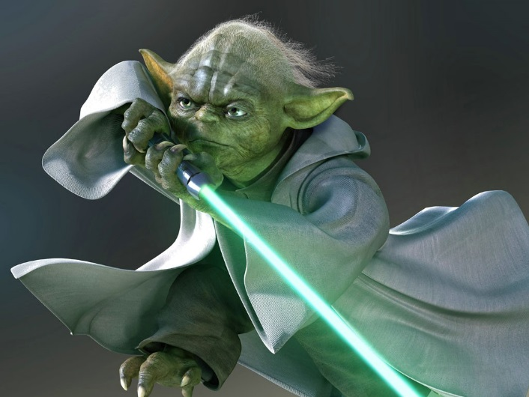
The “Armor”
The “Force”

Slide 3
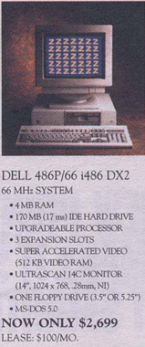
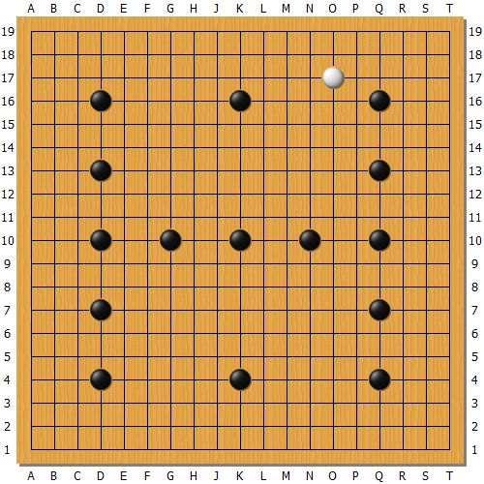
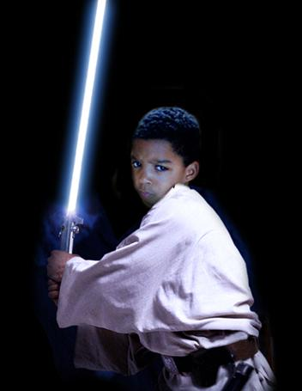


“Goliath”
1991
5D
“HandTalk”
1993
3D

Slide 4
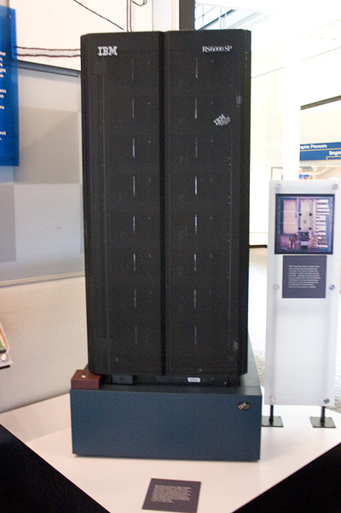
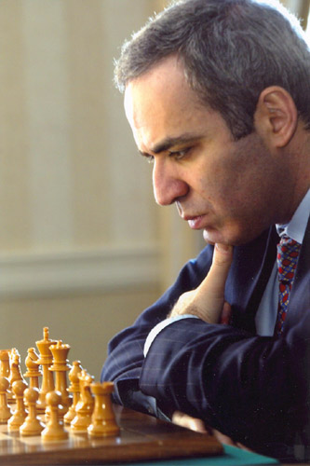
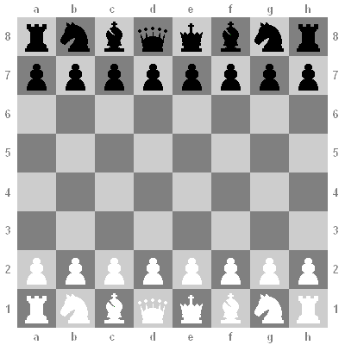

May 11th 1997, New York City, NY
First computer program to defeat a world champion
In Chess!

Slide 5
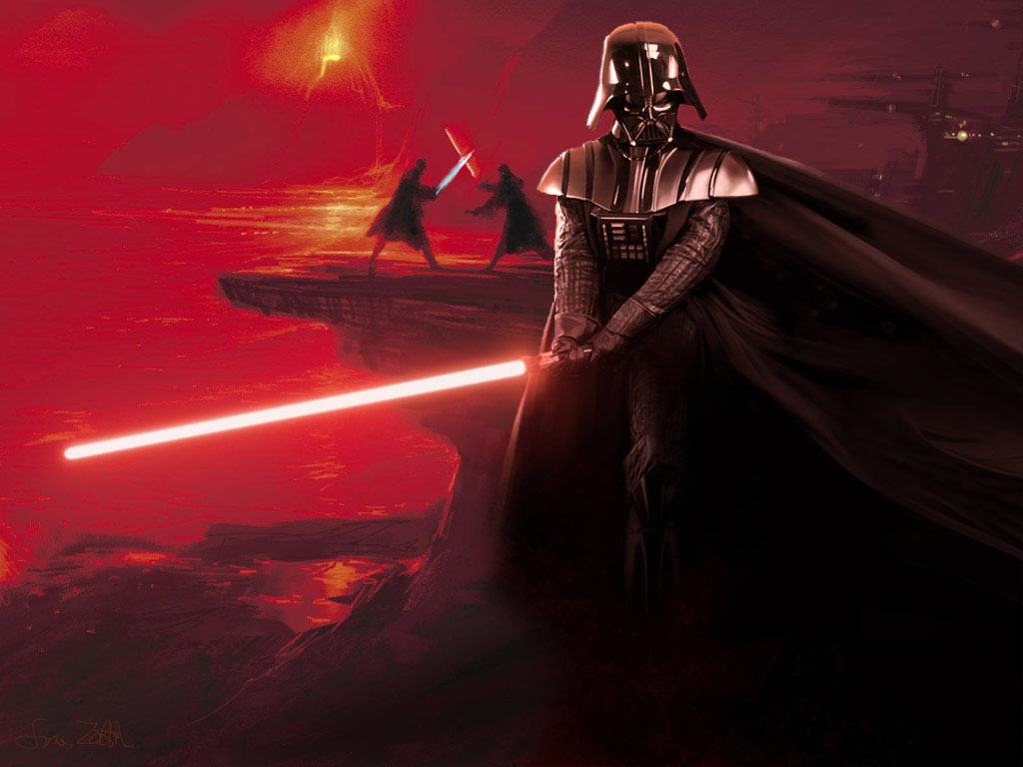
1997

Slide 6
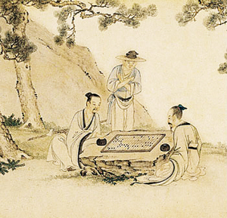
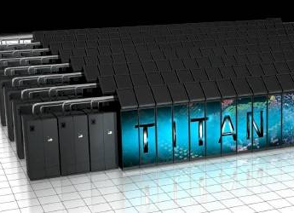
What about
Go?

Slide 7
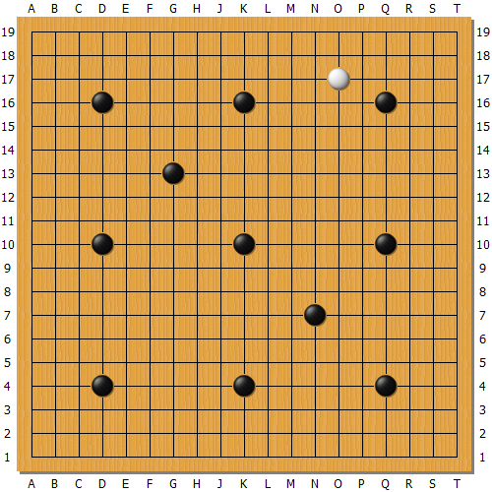
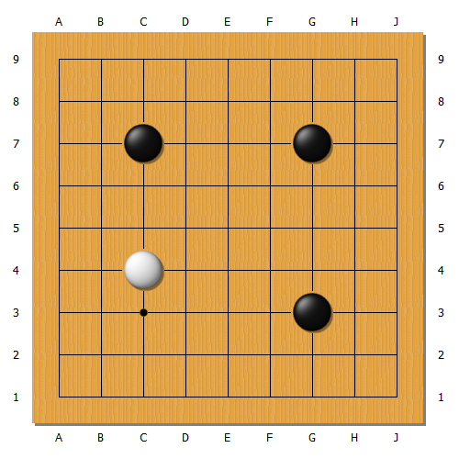
“HandTalk”
1997
Taiwan Insei
“MFGO”
1997
Janice Kim 1p

Slide 8
1997

Slide 9


What makes the difference?
19 x 19
Board size
8 x 8
free
Rule.
Defined for each piece
~200
Average Possible Moves.
~30
~200
Average Moves Per Game..
~30
10¹⁷⁰
Possible Variations
10⁴³
$$1\underset{170}{\underbrace{00000000…000}}$$
$$1\underset{43}{\underbrace{00000…000}}$$

Slide 10

10¹⁷⁰
Numbers! What do they mean?
10⁴³
10¹⁷
age of the universe in seconds
10²³
diameter of the galaxy in centimeters
10⁴⁸
number of water molecules on the Earth
10⁸⁰
number of atoms in observable universe

Slide 11
10⁴³
10¹⁷⁰
Go is way more complicated than Chess

Slide 12
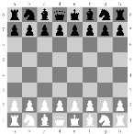
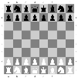
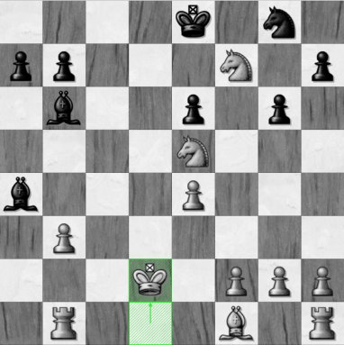
How does computer play chess?
1. Look for variations, as many as possible.
…
2. Evaluate board position.
… … … … …
… … … … …
… … … … …
3.1
1
…
… … … … …
… … … … …
3.3
5.0
…
3. Propagate back to find the best move.
…
… … … … …

Slide 13
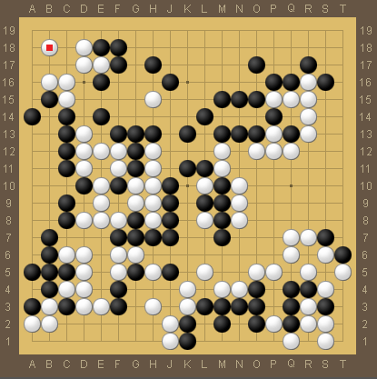
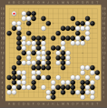
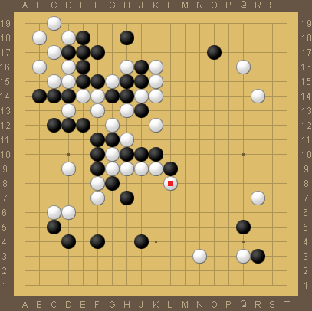
Why can’t computer play Go in the same way?
10¹⁷⁰ Too much more variations
…
… … … … …
… … … … …
Evaluation is difficult
… … … … …
…
… … … … …
… … … … …
…
…
How do you count?
… … … … …

Slide 14


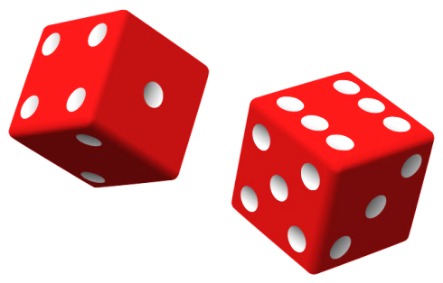
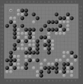
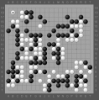
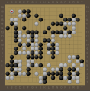
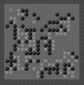
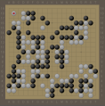
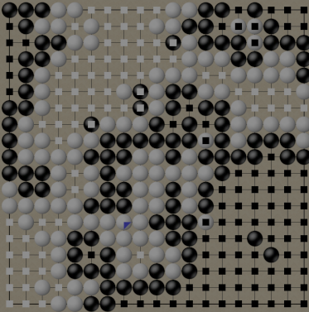
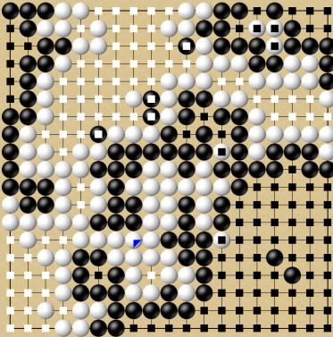
2006
Monte Carlo Tree Search (MCTS)
…
0.86245…
0.61733…
(from a position) Play a bunch of Random games
(to a state) where precise scoring can be done
Black Win
White Win
Assign “winning rate” to a certain move

Slide 15
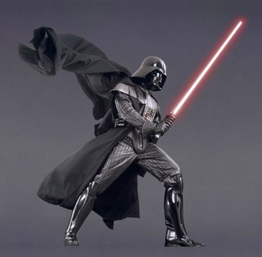
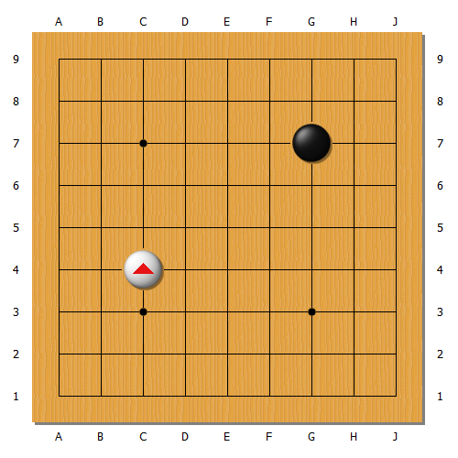
“MoGo”
2007
Guo Juan 5p
“MoGo”
2009
Chou Chun-hsun 9p
“Zen”
2011
Many p’s, including 9p

Slide 16
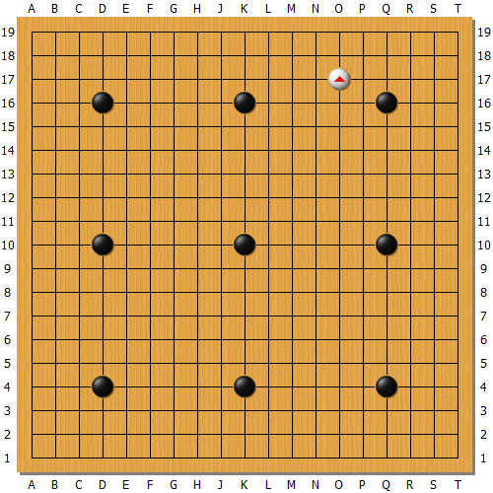
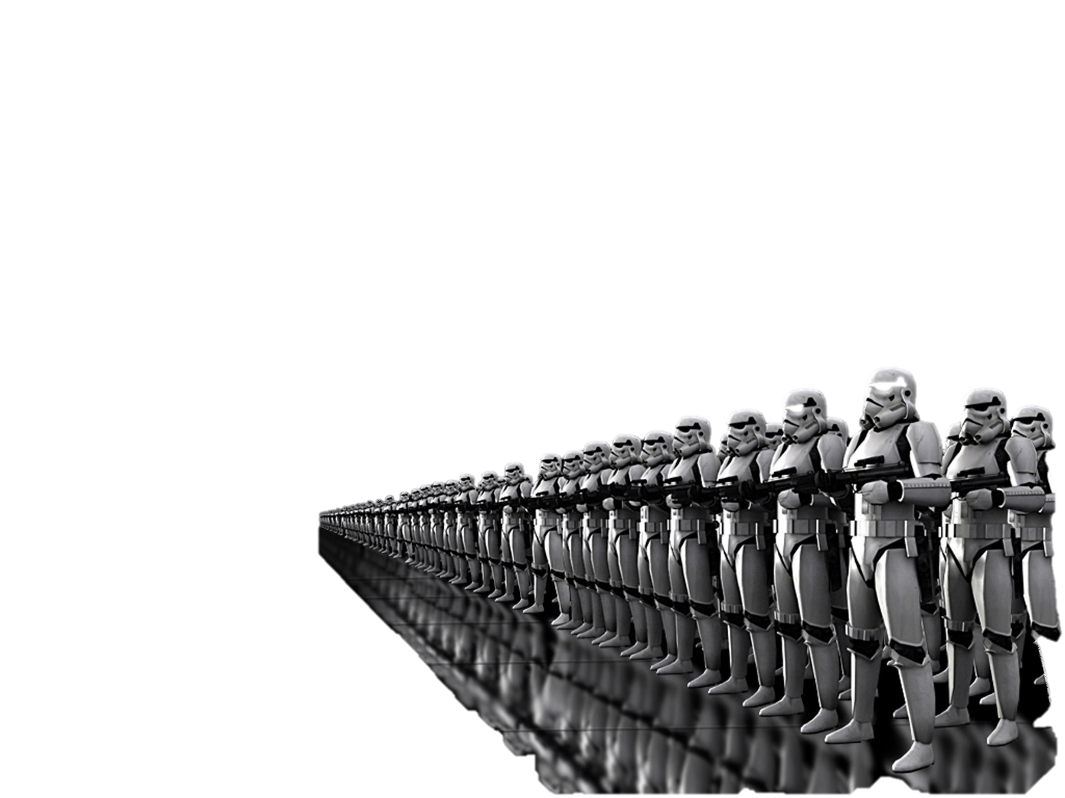
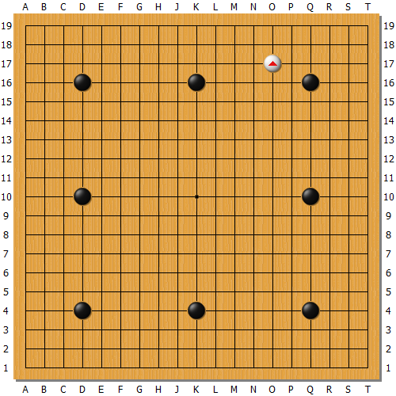
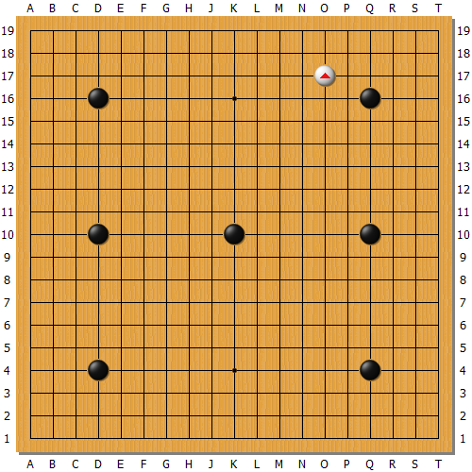
“MoGo”
2008
Kim Myungwan 8p
“CrazyStone”
2008
Wang Ming-wan 9p
640 core
“MoGo”
2009.2
Chou Chun-hsun 9p

Slide 17
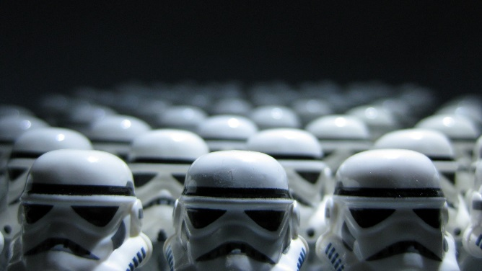
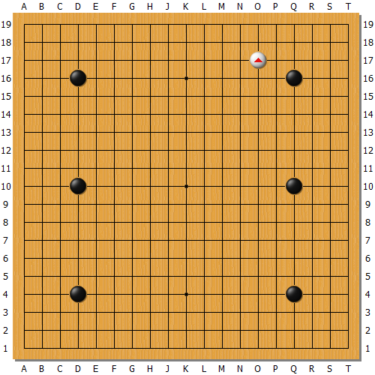
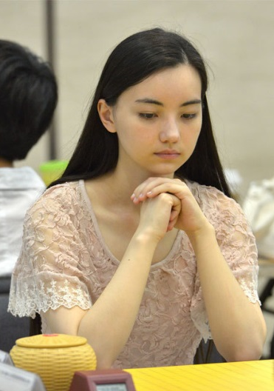


128 core
“MoGo”
2009.12
Chou Chun-hsun 9p
Many programs
2011.6
Joanne Missingham 6p
12 core “MoGo”
12 core “MFGO”
26 core “Zen”

Slide 18
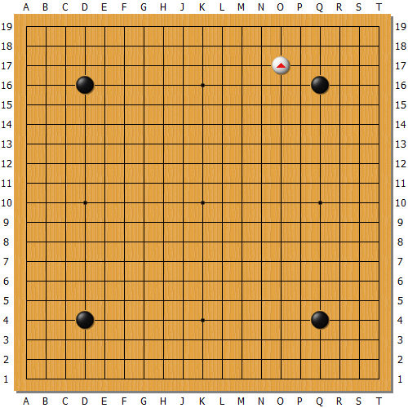
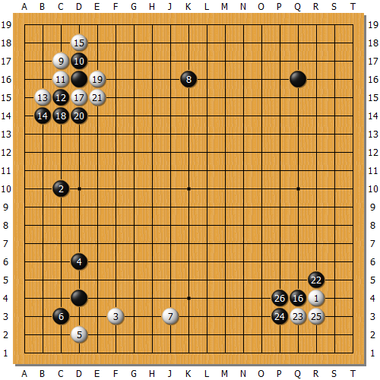
“Zen”
“CrazyStone”
2012
Chou Chun-hsun 9p
Masaki Takemiya 9p
Ishida Yoshio 9p
6/6/2013 (3 days ago)
Zen beats a strong amateur (Tygem 9d) with 3 handicaps

Slide 19

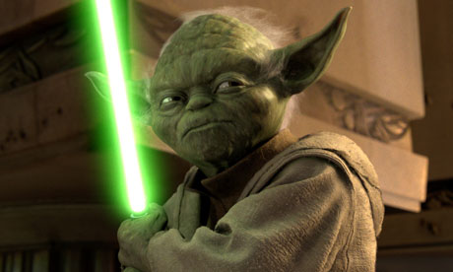
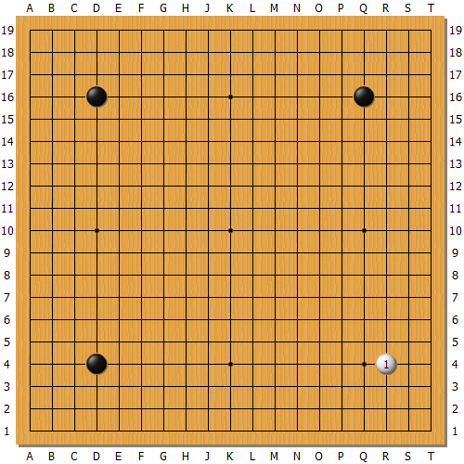

Do we have models for heuristics, domain specific knowledge as the “Black Magic”?
Will Artificial Intelligence ever exceed human intelligence?
Find Answers, You will.
Do we need more computing power?

