Slide 1
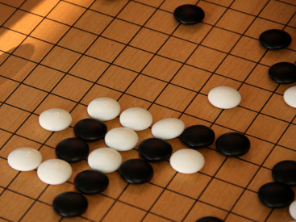
GO,
Not Just a Game! It’s a Lifestyle!
By Jie Tang (6D)
A Presentation for Huaxia Go Expo
White Plains, New York
June 9th , 2013

Slide 2
Essence of Go
An intellectual game with Simple equipment and easy to learn but difficult to master.
Integrated Arts:
  An intellectual game: Express mood (抒发意境), Cultivate sentiments (陶冶情操), Self-cultivation (修身养性), Mental health (生慧增智);
  Art of War Strategy (兵法策略), Global concept (治国安邦).

Slide 3
Essence of Go
Develops diligence, tenacity, and creativity-The essence of Chinese culture.
Life-long enjoyment
A good education program

Slide 4
GO – An educational program
Go Helps Brain Development for young kids (proved) :
  The human brain is about 60 % developed at the age of 3 and more than 90% developed by the age of 12 (grade six).
Go improve IQ and EQ (my hypothesis, not tested yet)

Slide 5
What will students learn?
Various Skills to improve IQ and EQ:
  Logical thinking
  Camera-shorts memory (replay 复盘)
  Mathematical operation
  Creativity
  Imagination
  Leadership skill

Slide 6
What will students learn?
  Efficiency (一箭双雕),
  Global concept (全局观)
  Empathy (换位思考)
  Prioritization (轻重缓急),
  Decision Making
  Time Management
  Basic Etiquette

Slide 7
Barriers to Promote Go in America
    Mr. Ing’s Dream – “Let Go light the world”
    But, we are faced with distractions such as
      Sport, Hollywood, Pop cultural, Facebook…
      Long term attention vs. video game (instant gratification)
      Not enough coaches
      Lack of publicity

Slide 8
My Teaching Experience
Teaching GO the American way: make it fun and challenging
  Vivid illustrations using real life examples.
  Reward progress
  Serve refreshments
  Organize regular GO tournaments

Slide 9
Going forward….
Make GO as educational program in America
More Publicity
  Publications in local newspaper and magazines
  Raise awareness of Worldwide GO events
  Help the GO movie

